Slide 1
Medicose medical service App Usability Study
03/03/2023
UX Analysis Team
Vishal Ram
shyam

Slide 2
Table of Contents
Section 1 Study Details
Section 2 Themes
Section 3 Insights & Recommendations

Slide 3
Study Details

Slide 4
Project Background
We’re creating a Medicose medical service app for peoplesfor ease of medical faclities like appointments, ordering medicene, test’s etc. our dream to make the ease of medical faclity in such a way they can handle as per their choice and also try to make the medical service best and fast.

Slide 5
Study Details
Research Questions
Participants
Methodology
how long to book the appointment of doctor.
Are users able to successfully book the appointment that they want?
how long to order the medicine and test ?
Any bottleneck through the process
8participants
Participants between the ages of 16-62 who reside in NCR area (INDIA)
25-30 minutes
India , remote
Unmoderated usability study)
Users were asked to order and book appointment through low fidelity modal

Slide 6
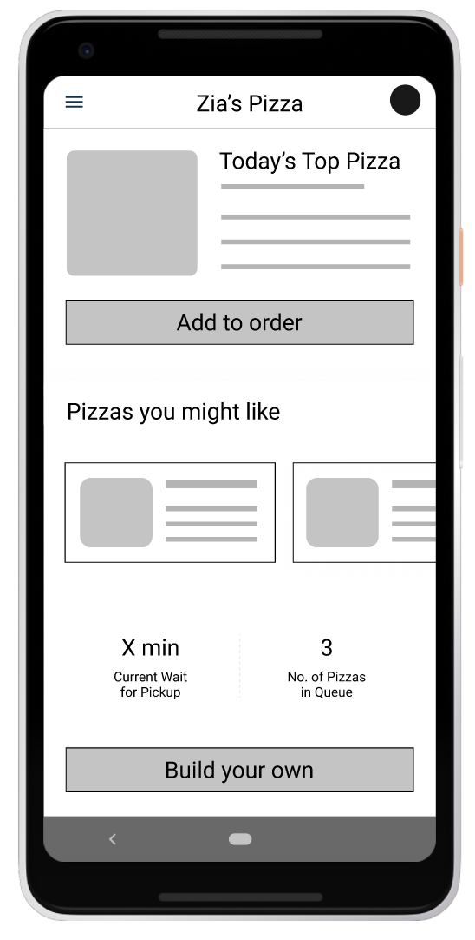
Prototype Tested
The low-fidelity app prototype for Medicose app was tested and can be viewed here.

Slide 7
Themes

Slide 8
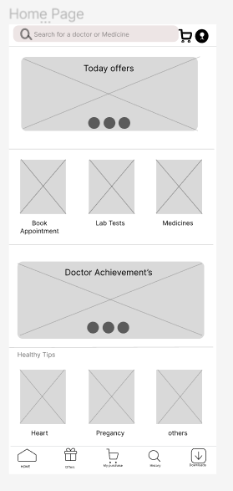
People want to order apponitment online
Supporting evidence from the usability study.
3 out of 5 total participants they are looking for some online appointment app which save their time
“I am working profesional need to order appointment for my parents who live in different city .”
— Ram, (NCR delhi)

Slide 9
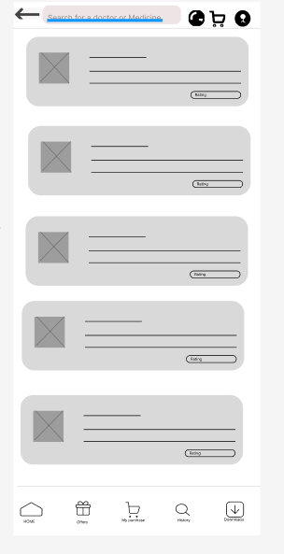
People want to order medicine online
Supporting evidence from the usability study.
4 out of 5 said they want some solution to order the medicine online to save time
3 of5 those participants notedthier must be option which five reminder of buying this medicine
“I’m ram we need a solutio to order medicine online also thay give reminder to take the medicine on time or alert when the medicine is empty so we plan accordingly.”
— shyam NCR delhi

Slide 10
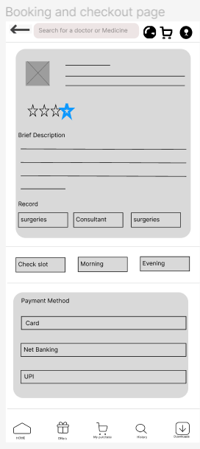
People want more payment options
Supporting evidence from the usability study.
3 out of 5 total participants said they want more payment options
“I am using UPI for payment it’s easy and fast so it should be incorparated .”
— sita, NCR india

Slide 11
Insights & Recommendations

Slide 12
Research insights
Fast ordering
Payment options
Delivery option
Users need a way to order more quickly without having to go to clinic and medical shopes
Users have multiple payment option so that it’s easy for user to pay the bill
Tracking and delivery option save time

Slide 13
Recommendations
Add a “more payment optionprovide user easy to pay accordingly with ease
Add “more qty of same medicine ” allow user to keep the ordering one time for whole month
Add “reminder to buy ”option allow user to keep track of medicine

Slide 14
Thank you!

